Slide 1
AVID-FP Store: A Fault-Tolerant, Integrity-Verified Distributed Object Store
- MANOJ, SNEHITHA
Notes:
Over the next few minutes, I’ll show how we’ve combined erasure coding, homomorphic fingerprinting, and the AVID-FP consensus protocol to build a mini-S3-style system that survives up to two node failures, detects every bit flip, and runs entirely in Go with built-in observabili

Slide 2
Problem & Motivation
What can go wrong?
Project goal
How we attack it
Learning Angle
Notes:
Imagine you have to park your data on a bunch of commodity servers—maybe in the cloud, maybe just down the hall—but you can’t fully trust them.
A server might crash, a disk might silently corrupt a block, or someone mis-configures a directory.
The easy answer is triple replication, but that inflates your storage and bandwidth by 200 percent.
Our project asks: Can we get the same reliability and prove integrity without that cost?
We do it in two steps we had to learn ourselves:
Reed–Solomon erasure coding: split a file into shards so any three of five can recreate the original.
Homomorphic fingerprints plus a tiny Echo/Ready consensus round: every server can verify shards and agree on integrity before they mark the write committed.
And we built all of this in Go with zero prior background, so the learning curve was a big win for us, too.
Quick recap of erasure coding: instead of cloning the whole file, you split it into n shards—say 5—where 3 are data and 2 are parity. If any two shards disappear, the remaining three still reconstruct the file. That gives us failure tolerance similar to triple replication, but with only 1.4 × storage overhead instead of 3 ×.”*
Let me show you what the design looks like…”

Slide 3
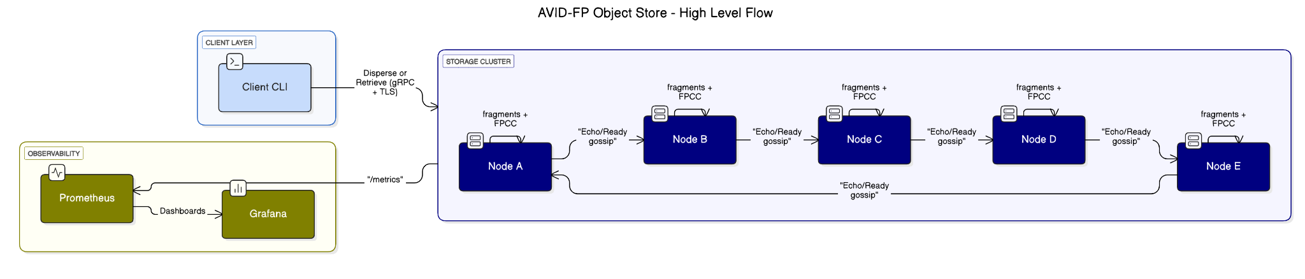
High-Level Design
Notes:
Step 1 – Client layer. On the left the CLI takes an input file, splits it with Reed–Solomon into five fragments, and constructs a cross-checksum we call FPCC—that’s SHA-256 plus an 8-byte homomorphic fingerprint for every shard. Then it fans out; each of the five nodes gets every fragment plus the same FPCC over gRPC. All network links are in parallel, so we saturate bandwidth.
Step 2 – Storage cluster. Zoom into one node: it validates the fragment against the FPCC, writes it atomically to disk, and persists the FPCC in BoltDB. Immediately it gossips an Echo message. • When any node sees m + f = 4 Echoes, it gossips Ready. • When a node sees 2 f + 1 = 3 Readies, it knows every honest server has the shard, so the write is committed. The quorum math means we can lose f = 2 nodes at any time—during the write or later—and still be safe.
Step 3 – Observability. Every server exposes Prometheus counters and histograms on /metrics. A single Prometheus job scrapes all five nodes, and Grafana renders live RPC-rate and latency dashboards with zero extra application logic.
This pipeline gives us durability, integrity, and real-time visibility while using only 40 % storage overhead instead of 200 % for triple-replication.”

Slide 4
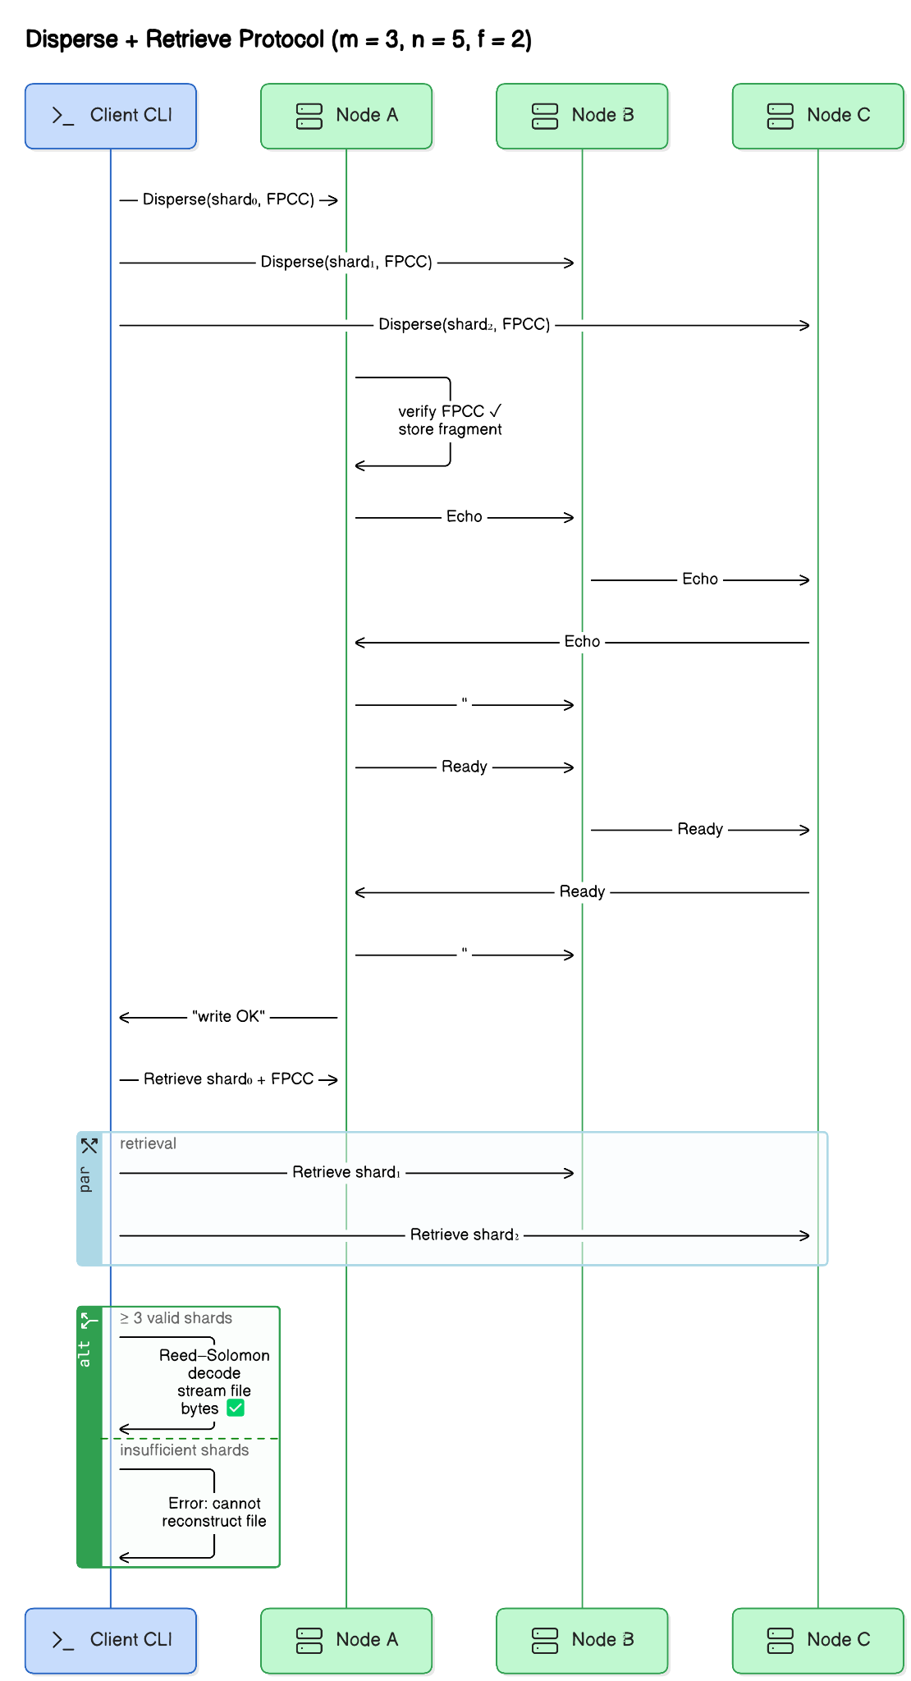
Write (Disperse)
&
Read (Retrieve)
Notes:
Fan-out send – the CLI streams each of the 5 fragments plus the FPCC to every node in parallel.
Shard verification – on arrival a node checks two things: • SHA-256 hash matches the FPCC entry. • Our 8-byte homomorphic fingerprint matches. Both are O(len(fragment)) and fully CPU-bound, so no extra I/O.
Durable store – the shard is written atomically to data/<obj>/<index>.bin and the FPCC goes into BoltDB. At this point the fragment survives a crash, but the object is not yet committed.
Echo / Ready mini-consensus – • Node broadcasts Echo—“I have a valid shard.” • When it hears m + f = 4 Echoes it broadcasts Ready. • When it hears 2 f + 1 = 3 Readies it closes the local commit channel; now the write is globally durable even if two nodes die immediately.
The server returns “write OK” to the client.
Read path ― “Retrieve” (bottom-half).
Client asks one node for shard 0 + FPCC.
It then pipeline-fetches other shards until it has m = 3 that pass both hash and fingerprint checks.
Reed–Solomon runs in streaming mode: if we ever drop below 3 good shards decoding aborts; otherwise it reconstructs bytes directly to the output file.
The integrity of both downloaded and reconstructed shards is re-verified, so we catch bit-flips during transit or decode.

Slide 5
Implementation
Tech Stack
Key design choices
Numbers (n = 5, m = 3, f = 2)
Extras
Notes:
Design trade-offs – We chose BoltDB over SQLite because it’s pure Go and embeddable. Updates are batched every 250 ms via a small channel buffer; this multiplies IOPS by roughly five on consumer SSDs.
Fingerprints use an 8-byte evaluation point instead of a full 32-byte MAC, keeping network overhead small.
Performance – On five commodity laptops the RS encoder with SIMD pushes 120 MB/s; the extra Echo/Ready round adds about 0.8 RTT over a plain PUT. Storage overhead is 1.4 × instead of 3 ×.
We validated tolerance by killing two nodes during a write; the client still succeeded and later reads reconstructed the file.
Operational goodies – A simple -snapshot flag zips BoltDB + fragment dirs for off-cluster backup; a TTL GC thread reclaims space automatically. Docker-compose plus Prometheus & Grafana give observability out-of-the-box. and also you can say about why did we choose reed-solomon for erasure coding and Rabins for Homographic fingerprinting

Slide 6

DEMO!
👨‍💻

Slide 7
Key Takeaways & Q/A
What we achieved !
What we learned !
What’s Next !
Notes:
What we achieved
✓ 40 % storage overhead instead of 200 %
✓ Survives 2 simultaneous node failures
✓ Cryptographic proof of every committed byte
✓ Live metrics, GC, snapshots, Docker one-liner
What we learned
• Erasure coding internals
• Consensus under Byzantine assumptions (AVID-FP)
• Go concurrency + gRPC at production scale
• Building observability from day 1
Immediate roadmap
• S3-compatible HTTP gateway → drop-in for existing apps
• Client-side caching & prefetch → lower read P99 latency
• Background “lazy repair” job → auto-heal missing shards
Stretch goals
• Dynamic membership: join/leave without downtime
• Pluggable K-MS support to encrypt each shard at rest
• Kubernetes Helm chart for one-command cluster deploy
Long-term vision
A campus-scale, self-healing object store that fits on ↙️
• 5–9 off-the-shelf servers
• Needs <2× raw capacity
• Provides cryptographic audit trails for every byte

